Slide 1

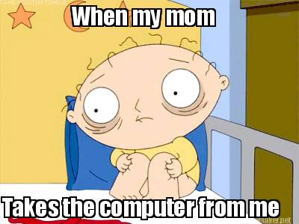
Unit-I
Computer Fundamentals
Yep!
Now, even a KID’s friend is Computer.
Introduction to Computers
Characteristics of Computers
Uses of Computers
Types of Computers
Generation of Computers

Slide 2
Sedulous: showing dedication and diligence
  E.g. He watched himself with the most sedulous care.
Nudge: a light touch or push, poke
  E.g. He gave her shoulder a nudge.

Slide 3
Nudge Theory
Nudge Theory: Humans, being not-so-rational, often need encouragement or intervention — a nudge — to get going and do what’s best for the country or society at large. The ‘Nudge Theory’ recognises this behavioural trait.
  It says that people, rather than being forced, can be encouraged and influenced to pursue or desist from certain actions through nudges.
The ‘nudge theory’ of economist Richard Thaler, mentioned extensively in the Economic Survey 2018-19
Public policy examples of ‘Nudge’ at work include automatic enrolment of employees into pension schemes in the UK and the opt-out system for organ donation in Spain. By making the optimal choice the default option for all citizens, these nudges have helped improve public participation in these programmes.

Slide 4
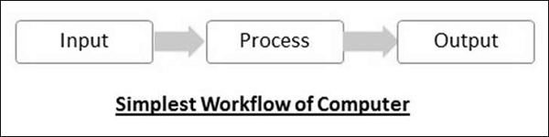
What’s a Computer
Computer is an electronic device that receives input, stores or processes the input as per user instructions and provides output in desired format.

Slide 5
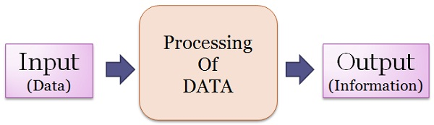
What’s a Computer
Computer input is called data and the output obtained after processing it, based on user’s instructions is called information.
Raw facts and figures which can be processed using arithmetic and logical operations to obtain information are called data.

Slide 6
Data vs. Information
Data is defined as the collection of facts and details like text, figures, observations, symbols or simply description of things, event or entity gathered with a view to drawing inferences. It is the raw fact, which should be processed to gain information. It is the unprocessed data, that contains numbers, statements and characters before it is refined by the researcher.
The term data is derived from Latin term ‘datum’ which refers to ‘something given’.

Slide 7
Data vs. Information
Information is described as that form of data which is processed, organised, specific and structured, which is presented in the given setting. It assigns meaning and improves the reliability of the data, thus ensuring understandability and reduces uncertainty. When the data is transformed into information, it is free from unnecessary details or immaterial things, which has some value to the researcher.
The term information discovered from the Latin word ‘informare’, which refers to ‘give form to’.

Slide 8
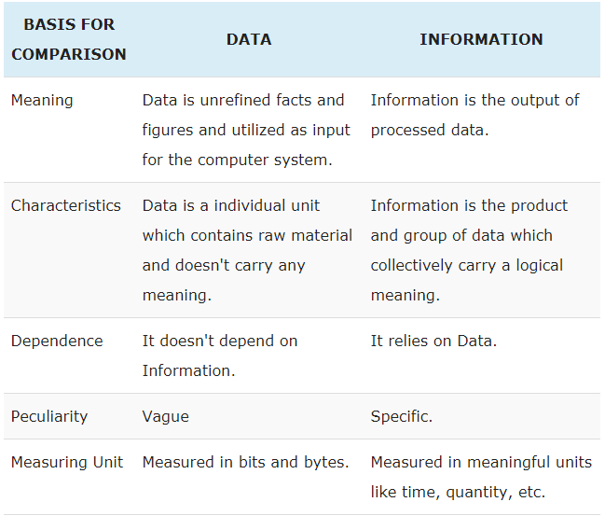
Data vs. Information

Slide 9
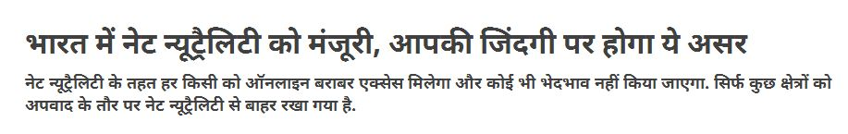

What is Net Neutrality…?

Slide 10

Net neutrality is the principle that individuals should be free to access all content and applications equally, regardless of the source, without Internet Service Providers discriminating against specific online services or websites.
In other words,
it is the principle that the company that connects you to the internet does not get to control what you do on the internet.

Slide 11
Dearth: lack of something
E.g. There is a dearth of evidence.

Slide 12
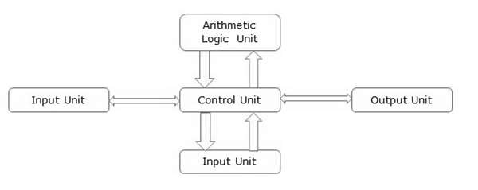
Basic Parts of a Computer

Slide 13
Basic Parts of a Computer
The basic parts of a computer are as follows −
Input Unit − Devices like keyboard and mouse that are used to input data and instructions to the computer are called input unit.
Output Unit − Devices like printer and visual display unit that are used to provide information to the user in desired format are called output unit.
Control Unit − As the name suggests, this unit controls all the functions of the computer. All devices or parts of computer interact through the control unit.

Slide 14
Basic Parts of a Computer
Arithmetic Logic Unit − This is the brain of the computer where all arithmetic operations and logical operations take place.
Memory − All input data, instructions and data interim to the processes are stored in the memory. Memory is of two types – primary memory and secondary memory. Primary memory resides within the CPU whereas secondary memory is external to it.
Control unit, arithmetic logic unit and memory are together called the central processing unit or CPU.

Slide 15
Advantages of Computers
High Speed
    It is capable of performing calculation of very large amount of data.
    The computer has units of speed in microsecond, nanosecond, and even the picosecond.
    It can perform millions of calculations in a few seconds as compared to man who will spend many months to perform the same task.
Accuracy
    In addition to being very fast, computers are very accurate.
    Computers perform all jobs with 100% accuracy provided that the input is correct.

Slide 16
Advantages of Computers
Storage Capability
    Memory is a very important characteristic of computers.
    A computer has much more storage capacity than human beings.
    It can store large amount of data.
    It can store any type of data such as images, videos, text, audio, etc.
Diligence
    Unlike human beings, a computer is free from monotony, tiredness, and lack of concentration.
    It can work continuously without any error and boredom.
    It can perform repeated tasks with the same speed and accuracy.

Slide 17
Advantages of Computers
Versatility
    A computer is very flexible in performing the jobs to be done.
    This machine can be used to solve the problems related to various fields.
    At one instance, it may be solving a complex scientific problem and the very next moment it may be playing a card game.
Reliability
    A computer is a reliable machine.
    Modern electronic components have long lives.
    Computers are designed to make maintenance easy

Slide 18
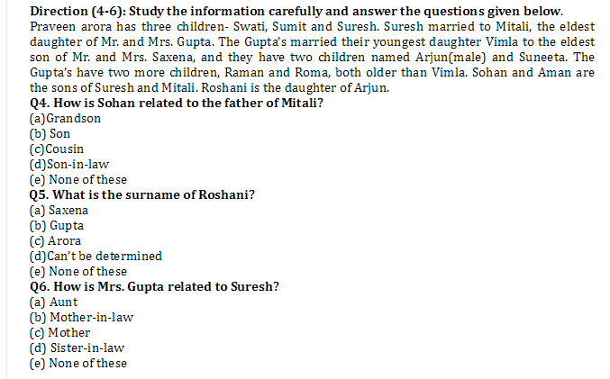
Advantages of Computers
Automation
    Automation is the ability to perform a given task automatically. Once the computer receives a program i.e., the program is stored in the computer memory, then the program and instruction can control the program execution without human interaction.
Reduction in Paper Work and Cost
    The use of computers for data processing in an organization leads to reduction in paper work and results in speeding up the process.
    As data in electronic files can be retrieved as and when required, the problem of maintenance of large number of paper files gets reduced.

Slide 19
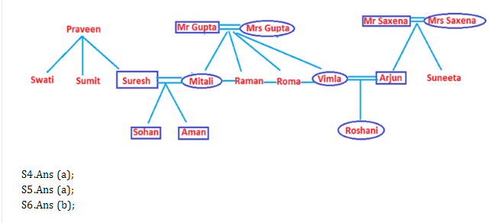

Slide 20
Disadvantages of Computers
No I.Q.
  A computer is a machine that has no intelligence to perform any task.
  Each instruction has to be given to the computer.
  A computer cannot take any decision on its own.
Dependency
  It functions as per the user’s instruction, thus it is fully dependent on humans.
Environment
  The operating environment of the computer should be dust free and suitable.
No Feeling
  Computers have no feelings or emotions.

Slide 21
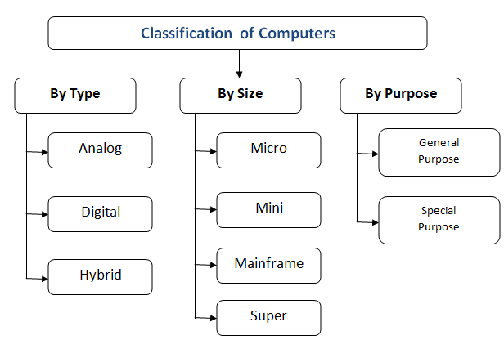
Classification/ Types of Computers

Slide 22
Classification by type/ technology used
Classification By Technology Used
According to the technology used, computers are of following three types:
1. Digital computers
2. Analog computers
3. Hybrid computers

Slide 23
Classification by type/ technology used
Digital Computers:
  Digital computers are mainly general purpose computers that represent and store data in discrete quantities or numbers.
  In these computers, all processing is done in terms of numeric representation (binary digits) of data and information.
  Although the user enters the data in decimal or character form, it is converted into binary digits (0s and 1s).
  For example: PC, Laptop etc.

Slide 24
Classification by type/ technology used
Analog Computers:
  Analog computers are special purpose computers that represent and store data in continuously varying physical quantities such as current, voltage or frequency.
  These computers are programmed for measuring physical quantities like pressure, temperature, speed, etc., and to perform computations on these measurements.
  Analog computers are mainly used for scientific and engineering applications.

Slide 25
Classification by type/ technology used
Some of the examples of Analog computers are:
  Thermometer: It is a simple analog computer used to measure temperature.
  Speedometer: Car’s speedometer is another example of analog computer where the position of the needle on dial represents the speed of the car.
Limitations of the Analog computer:
  These do not have logical facilities afforded by programming.
  They do not have the ability to store data in large quantities.
  Cost of implementation of computation is very high.

Slide 26
Classification by type/ technology used
Hybrid computers:
  Hybrid computers incorporate the technology of both analog and digital computers.
  These computers store and process analog signals which have been converted into discrete numbers using analog to digital converters.
  They can also convert the digital numbers into analog signals or physical properties using digital to analog converters.
  Hybrid computers are mainly used in artificial intelligence (robotics) and computer aided manufacturing (e.g., process control).
  For example: Automated Teller Machine (ATM).

Slide 27
Classification by Size and Capacity:
Microcomputers:
  Microcomputers are also called personal computers (PCs) and use microprocessor as its CPU, a memory unit, and input device and an output device.
  They are small in size. Also, they do not have large storage capacities.
  They are more commonly called personal computers because they are designed to be used by one person at a time.
  Popular uses for microcomputers include word processing, surfing the Web, sending and receiving e-mail, spreadsheet calculations, database management, editing photographs, creating graphics, and playing music or games.
  Few examples are IBM PC, PS/2, Apple II and Macintosh.

Slide 28
Classification by Size and Capacity:
Minicomputers:
  A minicomputer is a multi-user computer.
  They have high processing speed and high storage capacity than the microcomputers.
  Minicomputers can support 4-200 users simultaneously.
  They are used for real-time applications in industries, research centers etc.
  E.g. PDP-11, IBM (8000 series)

Slide 29
Classification by Size and Capacity:
Mainframe Computers:
  Mainframe Computers are multi-user, multi-programming and high performance computers.
  They operate at a very high speed, have very large storage capacity and can handle the workload of many users.
  These are generally used in centralized databases.
  Mainframe computers are used in organizations like banks or companies, where many people require frequent access to the same data.
  E.g. CDC 6600 and IBM ES000 series.

Slide 30
Classification by Size and Capacity:
Supercomputers:
  These are the largest and fastest computers.
  A super computer has a number of CPUs which operate in parallel to make it faster.
  They are used for massive data processing and solving very sophisticated problems i.e., in the fields of science and defense, designing and launching missiles, weather forecasting, biomedical research, aircraft design and automobile design.
  E.g. CRAY 3. India has a series of super computers called PARAM developed by C-DAC and ANURAG.

Slide 31
Nadir: the lowest or most unsuccessful point in a situation, the bottom
E.g. asking that question was nadir of my career.
Paper Bag Day is celebrated on 12 July globally every year to make people aware about the use of paper bags that contribute to fight with climate change and environment pollution.

Slide 32
Classification by Purpose
General Purpose Computer:
    General-purpose computer is the one that can work on different types of programs input to it and thus be used in countless applications.
    The programs are not permanently stored but are input at the time of execution.
    These computers are very versatile.
    Simply by using a general purpose computer and different software, various tasks can be accomplished, including writing and editing (word processing), manipulating facts in a data base, tracking manufacturing inventory, making scientific calculations etc.

Slide 33
Classification by Purpose
Special Purpose Computer:
    Special-purpose computer is the one that is designed to perform a specific task.
    The instructions (programs) to carry out the task are permanently stored in the machine.
    For the specific tasks, this type of computer works efficiently but such computers are not versatile.
    Such a computer system would be useful in playing graphic intensive Video Games, traffic lights control system, navigational system in an aircraft, weather forecasting, satellite launch / tracking etc.

Slide 34
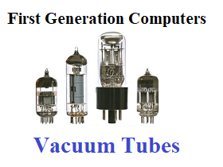
Computer Generations
First Generation (1940 to 1956): Using Vacuum Tubes
    Hardware Technology:
        The first generation of computers used vacuum tubes for circuitry and magnetic drums for memory. The input to the computer was through punched cards and paper tapes. The output was displayed as printouts.

Slide 35
Computer Generations
First Generation (1940 to 1956): Using Vacuum Tubes
    Software Technology :
        The instructions were written in machine language. Machine language uses 0s and 1s for coding of the instructions. The first generation computers could solve one problem at a time.
    Computing Characteristics:
        The computation time was in milliseconds.
    Physical Appearance:
        These computers were enormous in size and required a large room for installation.

Slide 36
Computer Generations
First Generation (1940 to 1956): Using Vacuum Tubes
    Application:
        They were used for scientific applications as they were the fastest computing device of their time.
    Examples:
        UNIVersal Automatic Computer (UNIVAC),
        Electronic Numerical Integrator And Calculator (ENIAC),
        Electronic Discrete Variable Automatic Computer (EDVAC)

Slide 37
Computer Generations
Disadvantages of 1st Generation:
    The first generation computers used a large number of vacuum tubes and thus generated a lot of heat.
    They consumed a great deal of electricity and were expensive to operate.
    The machines were prone to frequent malfunctioning and required constant maintenance.
    Since first generation computers used machine language, they were difficult to program.

Slide 38
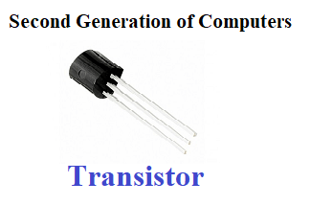
Computer Generations
Second Generation (1956 to 1963): Using Transistors
    Hardware Technology :
        Transistors replaced the vacuum tubes of the first generation of computers.
        Transistors allowed computers to become smaller, faster, cheaper, energy efficient and reliable.
        The second generation computers used magnetic core technology for primary memory. They used magnetic tapes and magnetic disks for secondary storage.
        The input was still through punched cards and the output using printouts.
        They used the concept of a stored program, where instructions were stored in the memory of computer.

Slide 39
Computer Generations
Second Generation (1956 to 1963): Using Transistors
    Software Technology:
        The instructions were written using the assembly language.
        Assembly language uses mnemonics like ADD for addition and SUB for subtraction for coding of the instructions.
        High-level programming languages, such as early versions of COBOL and FORTRAN were also developed during this period

Slide 40
Computer Generations
Second Generation (1956 to 1963): Using Transistors
    Computing Characteristics :
        The computation time was in microseconds.
    Physical Appearance :
        Transistors are smaller in size compared to vacuum tubes, thus, the size of the computer was also reduced.
    Examples: PDP-8, IBM 1401 and CDC 1604
    The cost of commercial production of these computers was very high, though less than the first generation computers. The transistors had to be assembled manually in second generation computers

Slide 41
Computer Generations
Third Generation (1964 to 1971): Using Integrated Circuits:
    Hardware Technology:
        The third generation computers used the Integrated Circuit (IC) chips.
        In an IC chip, multiple transistors are placed on a silicon chip.
        The use of IC chip increased the speed and the efficiency of computer, manifold.
        The keyboard and monitor were used to interact with the third generation computer, instead of the punched card and printouts.

Slide 42
Computer Generations
Third Generation (1964 to 1971): Using Integrated Circuits:
    Software Technology :
        The keyboard and the monitor were interfaced through the operating system. Operating system allowed different applications to run at the same time.
        High-level languages were used extensively for programming, instead of machine language and assembly language.
    Computing Characteristics:
        The computation time was in nanoseconds.

Slide 43
Computer Generations
Third Generation (1964 to 1971): Using Integrated Circuits:
    Physical Appearance :
        The size of these computers was quite small compared to the second generation computers.
    Examples: IBM 370, PDP 11.
    The third generation computers used less power and generated less heat than the second generation computers. The cost of the computer reduced significantly, as individual components of the computer were not required to be assembled manually. The maintenance cost of the computers was also less compared to their predecessors.

Slide 44
Computer Generations
Fourth Generation (1971 to present): Using Microprocessors
    Hardware Technology:
        They use the Large Scale Integration (LSI) and the Very Large Scale Integration (VLSI) technology. Thousands of transistors are integrated on a small silicon chip using LSI technology. VLSI allows hundreds of thousands of components to be integrated in a small chip.
        Microprocessor is a chip containing millions of transistors and components, and, designed using LSI and VLSI technology.
        Semiconductor memory replaced the earlier magnetic core memory, resulting in fast random access to memory.
        Secondary storage device like magnetic disks became smaller in physical size and larger in capacity.

Slide 45
Computer Generations
Fourth Generation (1971 to present): Using Microprocessors
        The linking of computers is another key development of this era. The computers were linked to form networks that led to the emergence of the Internet. This generation also saw the development of pointing devices like mouse, and handheld devices.
    Software Technology:
        Several new operating systems like the MS-DOS and MS- Windows developed during this time. This generation of computers supported Graphical User Interface (GUI).
        GUI is a user-friendly interface that allows user to interact with the computer via menus and icons.
        High-level programming languages are used for the writing of programs.

Slide 46
Computer Generations
Fourth Generation (1971 to present): Using Microprocessors
    Computing Characteristics:
        The computation time is in picoseconds.
    Physical Appearance :
        They are smaller than the computers of the previous generation.
    Ted Hoff produced the first microprocessor in 1971 for Intel. It was known as Intel 4004.

Slide 47
Computer Generations
Fifth Generation (Present and Next): Using Artificial Intelligence:
    The goal of fifth generation computing is to develop computers that are capable of learning and self-organization.
    The fifth generation computers use Super Large Scale Integrated (SLSI) chips that are able to store millions of components on a single chip.
    These computers have large memory requirements.
    This generation of computers uses parallel processing that allows several instructions to be executed in parallel, instead of serial execution. Parallel processing results in faster processing speed.

Slide 48
Computer Generations
Fifth Generation (Present and Next): Using Artificial Intelligence:
    Quantum computation and molecular and nanotechnology will radically change the face of computers in years to come.
    The goal of fifth-generation computing is to develop devices that respond to natural language input and are capable of learning and self-organization.

Slide 49
Auxiliary: functioning in a subsidiary capacity,
supplementary
e.g. Graduating from big-name schools translates into better jobs and higher salaries, according to conventional wisdom. Plus, there are the auxiliary benefits that also lead to cash—powerful alumni networks, name recognition that attracts the interest of hiring managers

Slide 50
PODCAST: A podcast is a type of digital media, usually audio, that is available in a series of episodes or parts and is streamed or downloaded by the end user over the Internet. Podcasts can be made available via a release schedule or uploaded to the Web randomly.

Slide 51
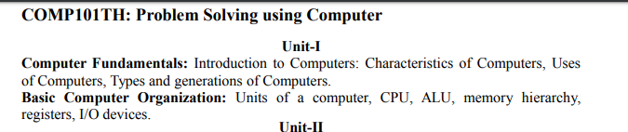

Slide 52
Basic Computer Organization
Difference between Computer Architecture and Computer Organization:
Computer Architecture is a functional description of requirements and design implementation for the various parts of computer. It deals with functional behavior of computer system. It comes before the computer organization while designing a computer.
Computer Organization comes after the decide of Computer Architecture first. Computer Organization is how operational attribute are linked together and contribute to realize the architectural specification. Computer Organization deals with structural relationship.

Slide 53
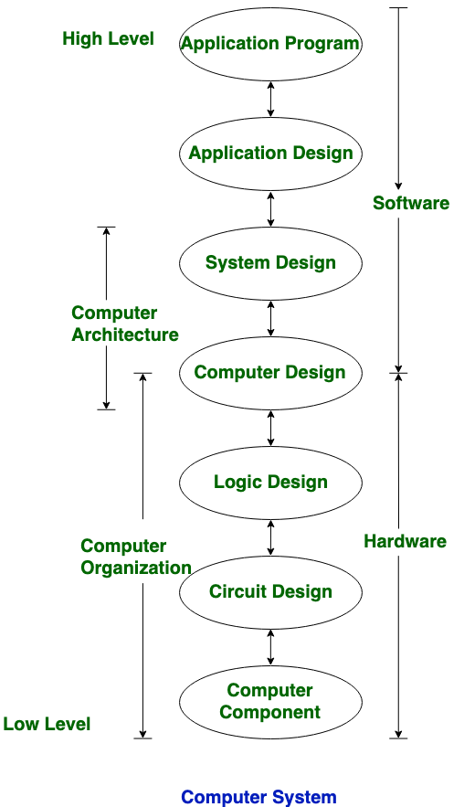
Basic Computer Organization
Architecture describes what the computer does.
Organization describes how it does it.

Slide 54
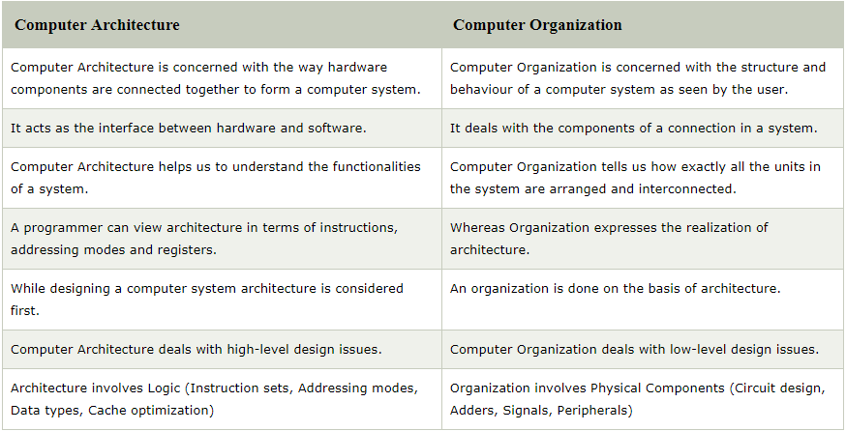
Basic Computer Organization

Slide 55
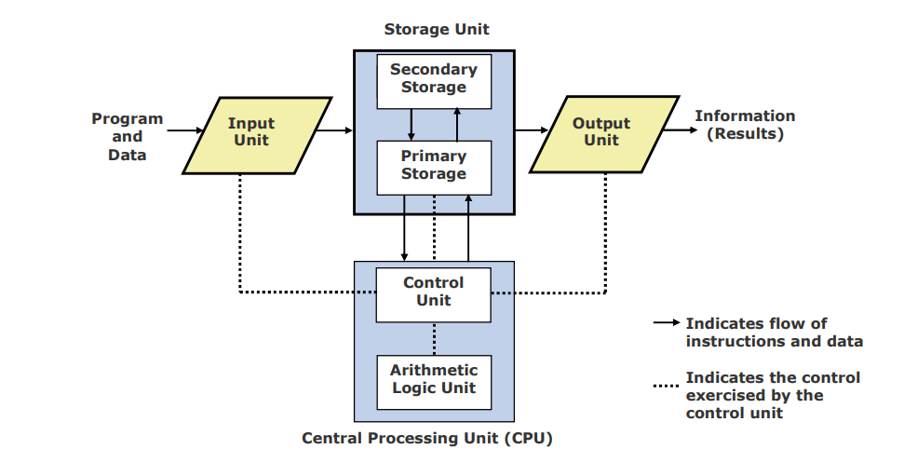
Basic Organization of a Computer System

Slide 56
A computer consists of input unit that takes input, a CPU that processes the input and an output unit that produces output.
All these devices communicate with each other through a common bus.
A bus is a transmission path, made of a set of conducting wires over which data or information in the form of electric signals, is passed from one component to another in a computer.
The bus can be of three types – Address bus, Data bus and Control Bus.

Slide 57
Following figure shows the connection of various functional components:

Slide 58
The address bus carries the address location of the data or instruction.
The data bus carries data from one component to another and the control bus carries the control signals.
The system bus is the common communication path that carries signals to/from CPU, main memory and input/output devices.
The input/output devices communicate with the system bus through the controller circuit which helps in managing various input/output devices attached to the computer.

Slide 59
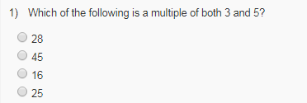
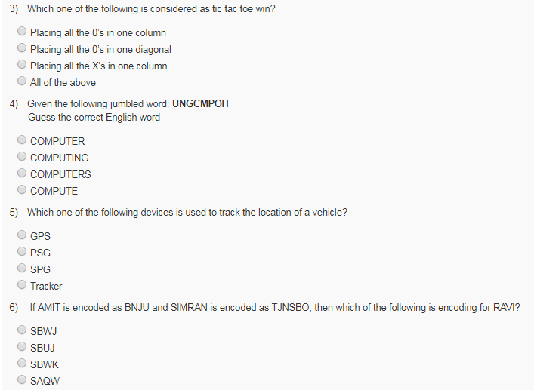

Slide 60
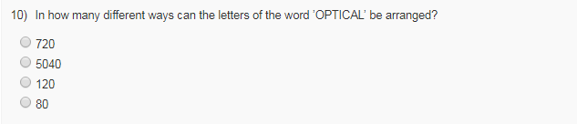

Slide 61
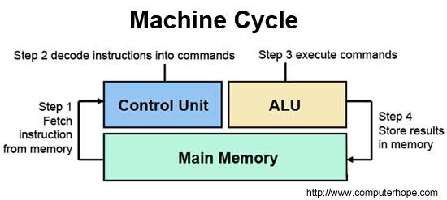
CPU
Alternately referred to as a processor, central processor, or microprocessor, the CPU is the central processing unit of the computer. A computer's CPU handles all instructions it receives from hardware and software running on the computer.
In the CPU, there are two primary components.
  ALU (arithmetic logic unit) - performs mathematical, logical, and decision operations.
  CU (control unit) - directs all the processors operations.

Slide 62
CPU
The following tasks are to be performed by the CPU:
  Fetch instructions: The CPU must read instructions from the memory.
  Interpret instructions: The instructions must be decoded to determine what action is required.
  Fetch data: The execution of an instruction may require reading data from memory or an I/O module.
  Process data: The execution of an instruction may require performing some arithmetic or logical operations on data.
  Write data: The results of an execution may require writing data to the memory or an I/O module.

Slide 63
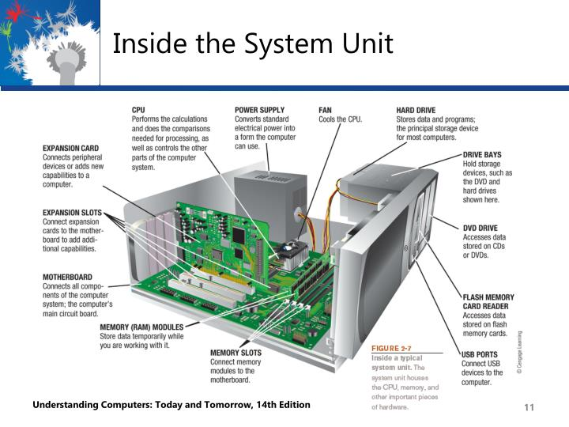

Slide 64
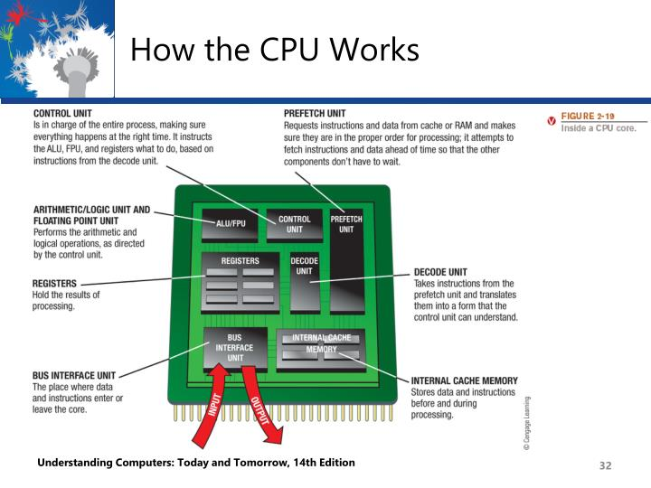

Slide 65
Memory Hierarchy
The memory is characterized on the basis of two key factors—capacity and access time. Capacity is the amount of information (in bits) that a memory can store.
Access time is the time interval between the read/ write request and the availability of data.
The lesser the access time, the faster is the speed of memory.
Ideally, we want the memory with fastest speed and largest capacity. However, the cost of fast memory is very high.
The computer uses a hierarchy of memory that is organized in a manner to enable the fastest speed and largest capacity of memory

Slide 66
Main Objectives of a Memory Hierarchy:
1. To minimize execution time of executing programs
2. To maximize the throughput of the computer
3. To minimize response time
subject to the constraint that high-speed memory is limited in size.

Slide 67
Two Principles of Locality
Temporal Locality: If an item is referenced, it will tend to be referenced again in the near future.
Spatial Locality: If an item is referenced, items whose addresses are close will tend to be referenced soon.
Empirical and theoretical justification:
  • programs tend to stay in loops, so instructions and their data are repeatedly accessed (temporal)
  • instructions tend to be executed sequentially (spatial)
  • data tends to be accessed sequentially, as in array accesses (spatial)
The Memory Hierarchy is based on the idea that the faster the memory, the more costly to build and therefore the smaller in capacity, and conversely, the larger the memory, the slower to access and less costly

Slide 68
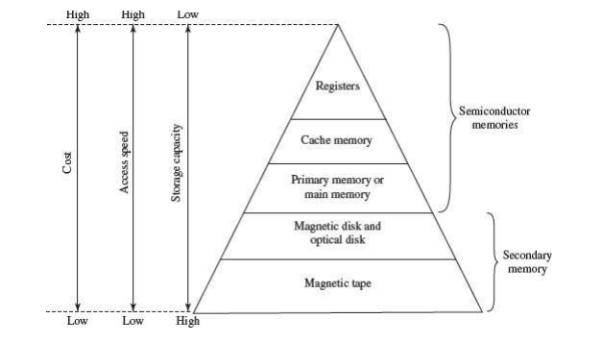
Memory Hierarchy

Slide 69
Memory Hierarchy
The internal memory and external memory are the two broad categories of memory used in the computer.
The internal memory consists of the CPU registers, cache memory and primary memory. The internal memory is used by the CPU to perform the computing tasks.
The external memory is also called the secondary memory. The secondary memory is used to store the large amount of data and the software.

Slide 70
Memory Hierarchy
Internal Memory—The key features of internal memory are—
  (1) limited storage capacity,
  (2) temporary storage,
  (3) fast access, and
  (4) high cost.
Registers, cache memory, and primary memory constitute the internal memory.

Slide 71
Registers
Registers are high-speed storage areas within the CPU, but have the least storage capacity. Registers are not referenced by their address, but are directly accessed and manipulated by the CPU during instruction execution.
Registers store data, instructions, addresses and intermediate results of processing. Registers are often referred to as the CPU’s working memory.
The data and instructions that require processing must be brought in the registers of CPU before they can be processed.
For example, if two numbers are to be added, both numbers are brought in the registers, added and the result is also placed in a register.

Slide 72
Registers
Registers are the top of the memory hierarchy and are the fastest way for the system to manipulate data.
Registers are normally measured by the number of bits they can hold, for example, an 8-bit register means it can store 8 bits of data or a 32-bit register means it can store 32 bit of data.
32-bit processor and 64-bit processor are the terms used to refer to the size of the registers.

Slide 73
Registers
Following are some commonly used registers:
Accumulator: This is the most common register, used to store data taken out from the memory.
General Purpose Registers: This is used to store data, intermediate results during program execution. It can be accessed via assembly programming.
Special Purpose Registers: Users do not access these registers. These registers are for Computer system,
  MAR: Memory Address Register are those registers that holds the address for memory unit.
  MBR: Memory Buffer Register stores instruction and data received from the memory and sent from the memory.
  PC: Program Counter points to the next instruction to be executed.
  IR: Instruction Register holds the instruction to be executed.

Slide 74
Cache Memory
A Cache is a small and very fast temporary storage memory. It is designed to speed up the transfer of data and instructions. It is located inside or close to the CPU chip. It is faster than RAM and the data/instructions that are most recently or most frequently used by CPU are stored in cache.
The data and instructions are retrieved from RAM when CPU uses them for the first time. A copy of that data or instructions is stored in cache. The next time the CPU needs that data or instructions, it first looks in cache. If the required data is found there, it is retrieved from cache memory instead of main memory. It speeds up the working of CPU.

Slide 75
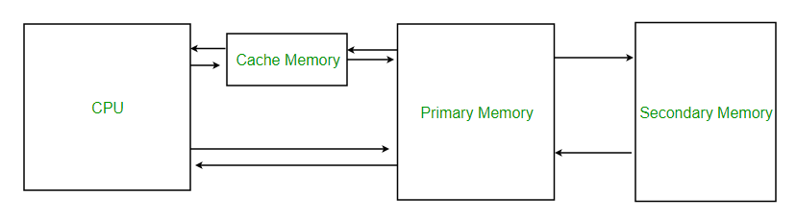
Cache Memory
Cache memory is costlier than main memory or disk memory but economical than CPU registers. Cache memory is an extremely fast memory type that acts as a buffer between RAM and the CPU. It holds frequently requested data and instructions so that they are immediately available to the CPU when needed.
Cache memory is used to reduce the average time to access data from the Main memory.

Slide 76
Why Cache/ Purpose of Cache
The purpose of cache memory is to store program instructions and data that are used repeatedly in the operation of programs or information that the CPU is likely to need next.
The computer processor can access this information quickly from the cache rather than having to get it from computer's main memory.
Fast access to these instructions increases the overall speed of the program.
As the microprocessor processes data, it looks first in the cache memory. If it finds the instructions or data it's looking for there from a previous reading of data, it does not have to perform a more time-consuming reading of data from larger main memory or other data storage devices.
Cache memory is responsible for speeding up computer operations and processing.

Slide 77
How Cache works?
The ability of cache memory to improve a computer's performance relies on the concept of locality of reference. Locality describes various situations that make a system more predictable, such as where the same storage location is repeatedly accessed, creating a pattern of memory access that the cache memory relies upon.
There are several types of locality. Two key ones for cache are temporal and spatial.
Temporal locality is when the same resources are accessed repeatedly in a short amount of time.
Spatial locality refers to accessing various data or resources that are in close proximity to each other.

Slide 78
Cache Memory
The following are the different levels of Cache Memory.
Level 1 (L1) Cache
  It is also called primary or internal cache. It is built directly into the processor chip. It has small capacity from 8 kB to 128 kB.
Level 2 (L2) Cache
  It is slower than L1 cache. The current processors contain advanced transfer cache on processor chip that is a type of L2 cache. The common size of this cache is from 512 kB to 8 MB.

Slide 79
Cache Memory
Level 3 (L3) Cache
  This cache is separate from processor chip on the motherboard. It exists on the computer that uses L2 advanced transfer cache. It is slower than L1 and L2 cache. The personal computer often has up to 8 MB of L3 cache.

Slide 80
Primary Memory/Main Memory
Primary memory is the main memory of computer. It is a chip mounted on the motherboard of computer.
Primary memory is categorized into two main types-
  Random Access Memory (RAM), and
  Read Only Memory (ROM)

Slide 81
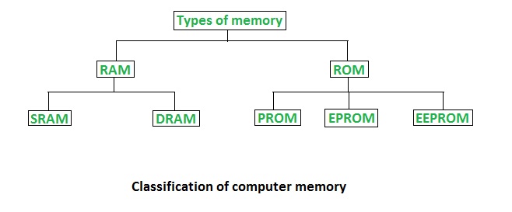
Primary Memory/Main Memory
Primary Memory

Slide 82
Random Access Memory
RAM is used to store data and instructions during the operation of computer.
  The data and instructions that need to be operated upon by CPU are first brought to RAM from the secondary storage devices like the hard disk.
  CPU interacts with RAM to get the data and instructions for processing.

Slide 83
Random Access Memory
RAM loses information when the computer is powered off. It is a volatile memory.
When the power is turned on, again, all files that are required by the CPU are loaded from the hard disk to RAM.
Since RAM is a volatile memory, any information that needs to be saved for a longer duration of time must not be stored in RAM.

Slide 84
Random Access Memory
RAM provides random access to the stored bytes, words, or larger data units. This means that it requires same amount of time to access information from RAM, irrespective of where it is located in it.
RAM can be read from and written to with the same speed.
The size of RAM is limited due to its high cost. The size of RAM is measured in MB or GB.
RAM is a microchip implemented using semiconductors.

Slide 85
Random Access Memory
There are two categories of RAM, depending on the technology used to construct a RAM—
  (1) Dynamic RAM (DRAM), and
  (2) Static RAM (SRAM).

Slide 86
DRAM
DRAM is the most common type of memory chip. DRAM is mostly used as main memory since it is small and cheap.
  It uses transistors and capacitors. The transistors are arranged in a matrix of rows and columns. The capacitor holds the bit of information 0 and 1. The transistor and capacitor are paired to make a memory cell.
  DRAM must be refreshed continually to store information.
  DRAM gets its name from the refresh operation that it requires to store the information; otherwise it will lose what it is holding. The refresh operation occurs automatically thousands of times per second. DRAM is slow because the refreshing takes time.
  Access speed of DRAM ranges from 50 to 150 ns.

Slide 87
SRAM
SRAM uses multiple transistors (four to six), for each memory cell. It does not have a capacitor in each cell.
A SRAM memory cell has more parts so it takes more space on a chip than DRAM cell.
It does not need constant refreshing and therefore is faster than DRAM.
SRAM is more expensive than DRAM, and it takes up more space.
It stores information as long as it is supplied with power.
SRAM are easier to use and very fast. The access speed of SRAM ranges from 2– 10 nanosecond.

Slide 88
RAM
Memory chips are generally available as part of a card called a memory module. There are generally two types of RAM modules—Single Inline Memory Module (SIMM) and Dual Inline Memory Module (DIMM).
SIMM modules have memory chip on one side of the PCB. SIMM modules can store 8 bits to 32 bits of data simultaneously.
DIMM modules have memory chips on both sides of the PCB. DIMM format are 64–bit memories.
Smaller modules known as Small Outline DIMM (SO DIMM) are designed for portable computers. SO DIMM modules have 32–bit memory.

Slide 89
Read Only Memory (ROM)
ROM is a non-volatile primary memory. It does not lose its content when the power is switched off.
ROM, as the name implies, has only read capability and no write capability. After the information is stored in ROM, it is permanent.
ROM comes programmed by the manufacturer. It stores standard processing programs that permanently reside in the computer. ROM stores the data needed for the start up of the computer. The instructions that are required for initializing the devices attached to a computer are stored in ROM.

Slide 90
Read Only Memory (ROM)
The ROM memory chip stores the Basic Input Output System (BIOS).
BIOS provides the processor with the information required to boot the system.
It provides the system with the settings and resources that are available on the system.
BIOS is a permanent part of the computer. It does not load from disk but instead is stored in a ROM memory chip.

Slide 91
Read Only Memory (ROM)
When the computer is turned on, the BIOS does the following things:
  Power On Self Test (POST) is a program that runs automatically when the system is booted. BIOS performs the power-on self-test. It checks that the major hardware components are working properly.
  BIOS setup program, which is a built-in utility in BIOS, lets the user set the many functions that control how the computer works. BIOS displays the system settings and finds the bootable devices. It loads the interrupt handlers and device drivers. It also initializes the registers.
  Bootstrap Loader is a program whose purpose is to start the computer software for operation when the power is turned on. It loads the operating system into RAM and launches it. It generally seeks the operating system on the hard disk. The bootstrap loader resides in the ROM. The BIOS initiates the bootstrap sequence.

Slide 92
Types of ROM
All the different kinds of ROM retain their content when the power is turned off.
PROM (Programmable ROM ) can be programmed with a special tool, but after it has been programmed the contents cannot be changed.
EPROM (Erasable Programmable ROM) can be programmed in a similar way as PROM, but it can be erased by exposing it to ultra violet light and re-programmed. EPROM chips have to be removed from the computer for re-writing.
EEPROM (Electrically Erasable Programmable ROM) memories can be erased by electric charge and re-programmed. EEPROM chips do not have to be removed from the computer for re-writing.

Slide 93
Secondary Memory
RAM is expensive and has a limited storage capacity. Since it is a volatile memory, it cannot retain information after the computer is powered off. Thus, in addition to primary memory, an auxiliary or secondary memory is required by a computer. The secondary memory is also called the storage device of computer.
In comparison to the primary memory, the secondary memory stores much larger amounts of data and information (for example, an entire software program) for extended periods of time. The data and instructions stored in secondary memory must be fetched into RAM before processing is done by CPU.
Magnetic tape drives, magnetic disk drives, optical disk drives and magneto-optical disk drives are the different types of storage devices.

Slide 94
ACCESS TYPES OF STORAGE DEVICES
The information stored in storage devices can be accessed in two ways—
    1. Sequential access
    2. Direct access
Sequential Access Devices:
  Sequential access means that computer must run through the data in sequence, starting from the beginning, in order to locate a particular piece of data.
  Magnetic tape is an example of sequential access device. Let us suppose that magnetic tape consists of 80 records. To access the 25threcord, the computer starts from first record, then reaches second, third etc. until it reaches the 25th record.
  Sequential access devices are generally slow devices.

Slide 95
ACCESS TYPES OF STORAGE DEVICES
Direct Access Devices:
  Direct access devices are the ones in which any piece of data can be retrieved in a non-sequential manner by locating it using the data’s address. It accesses the data directly, from a desired location.
  Magnetic disks and optical disks are examples of direct access devices. There is no predefined order in which one can read and write data from a direct access device.
  In a magnetic disk consisting of 80 records, to access the 25th record, the computer can directly access the 25th record, without going past the first 24 records.
  Based on access, magnetic tapes are sequential access devices, and, magnetic disks, optical disk and magneto-optical disks are direct access devices.

Slide 96
Magnetic Tape
Magnetic tape is a plastic tape with magnetic coating.
It is a storage medium on a large open reel or in a smaller cartridge or cassette (like a music cassette). Magnetic tapes are cheaper storage media.
They are durable, can be written, erased, and re-written.
Magnetic tapes are sequential access devices, which mean that the tape needs to rewind or move forward to the location where the requested data is positioned in the magnetic tape. Due to their sequential nature, magnetic tapes are not suitable for data files that need to be revised or updated often.
They are generally used to store back-up data that is not frequently used or to transfer data from one system to other.

Slide 97
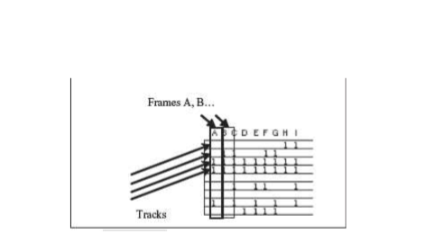
Working of Magnetic Tape
Magnetic tape is divided horizontally into tracks (7 or 9) and vertically into frames. A frame stores one byte of data, and a track in a frame stores one bit. Data is stored in successive frames as a string with one data (byte) per frame.

Slide 98
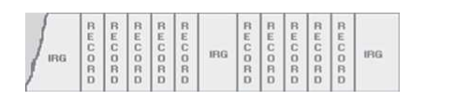
Working of Magnetic Tape
Data is recorded on tape in the form of blocks, where a block consists of a group of data also called as records. Each block is read continually. There is an Inter-Record Gap (IRG) between two blocks that provides time for the tape to be stopped and started between records.

Slide 99
Working of Magnetic Tape
Magnetic tape is mounted on a magnetic tape drive for access. The magnetic tape moves on tape drive from the supply reel to take-up reel, with its magnetic coated side passing over the read/write head.
Tapes are categorized based on their width - ¼ inch, ½ inch, etc.
The storage capacity of the tape varies greatly. A 10–inch diameter reel of tape which is 2400 feet long can store up to 180 million characters.

Slide 100
Magnetic Disks
Magnetic disk is a direct access secondary storage device. It is a thin plastic or metallic circular plate coated with magnetic oxide and encased in a protective cover. Data is stored on magnetic disks as magnetized spots.

Slide 101
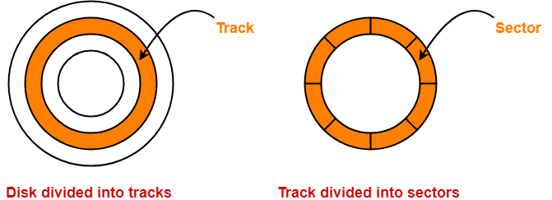
Magnetic Disk Architecture
The entire disk is divided into platters.
Each platter consists of concentric circles called as tracks.
These tracks are further divided into sectors which are the smallest divisions in the disk.

Slide 102
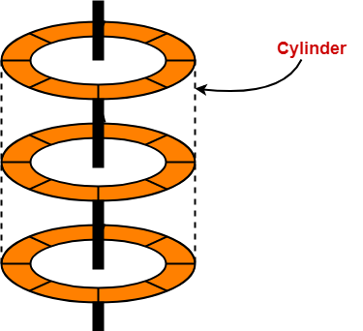
Magnetic Disk Architecture
A cylinder is formed by combining the tracks at a given radius of a disk pack.

Slide 103
Magnetic Disk Architecture
There exists a mechanical arm called as Read / Write head.
It is used to read from and write to the disk.
Head has to reach at a particular track and then wait for the rotation of the platter.
The rotation causes the required sector of the track to come under the head.
Each platter has 2 surfaces- top and bottom and both the surfaces are used to store the data.
Each surface has its own read / write head.

Slide 104
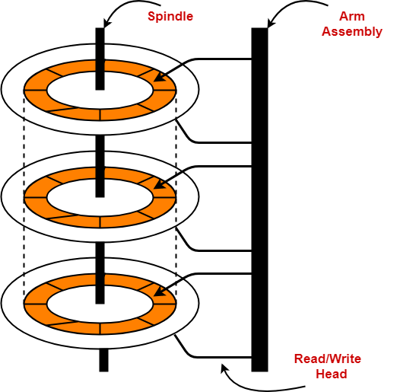
Magnetic Disk Architecture

Slide 105
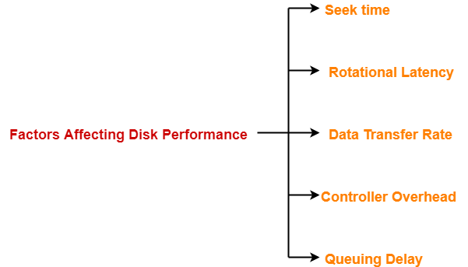
Disk Performance Parameters

Slide 106
Disk Performance Parameters
Seek Time-
  The time taken by the read / write head to reach the desired track is called as seek time.
  It is the component which contributes the largest percentage of the disk service time.
  The lower the seek time, the faster the I/O operation.

Slide 107
Disk Performance Parameters
Rotational Latency/ Latency Time-
  The time taken by the desired sector to come under the read / write head is called as rotational latency.
  It depends on the rotation speed of the spindle.
Data Transfer Rate-
  The amount of data that passes under the read / write head in a given amount of time is called as data transfer rate.
  The time taken to transfer the data is called as transfer time.

Slide 108
Disk Performance Parameters
Controller Overhead-
  The overhead imposed by the disk controller is called as controller overhead.
  Disk controller is a device that manages the disk.
Queuing Delay-
  The time spent waiting for the disk to become free is called as queuing delay.

Slide 109
Consider a hard disk with:
4 surfaces
64 tracks/surface
128 sectors/track
256 bytes/sector
Q:1 What is the capacity of the hard disk?

Slide 110
Disk capacity = surfaces * tracks/surface * sectors/track * bytes/sector
Disk capacity = 4 * 64 * 128 * 256
Disk capacity = 8 MB

Slide 111
Consider a disk pack with the following specifications- 16 surfaces, 128 tracks per surface, 256 sectors per track and 512 bytes per sector.
Q: What is the capacity of disk pack?

Slide 112
Capacity of disk pack
= Total number of surfaces x Number of tracks per surface x Number of sectors per track x Number of bytes per sector

Slide 113
16 x 128 x 256 x 512 bytes
= 2²⁸ bytes
= 256 MB

Slide 114
Assignment
Write a short note on:
  Floppy Disk
  CR-ROM
  DVD-ROM
  Optical Disks

Slide 115
I/O Devices
Input Devices:
  Keyboard, Mouse, Digitizing Tablet, Track Ball, Joystick, TouchScreen, Light Pen, Speech Recognition System, Digital camera, Scanner, Magnetic Ink Character Recognition (MICR), Optical Character Recognition (OCR), Optical Mark Recognition (OMR), Barcode Reader
Output Devices:
  Monitor, Visual Display Terminal, Printer, Plotter,

Slide 116
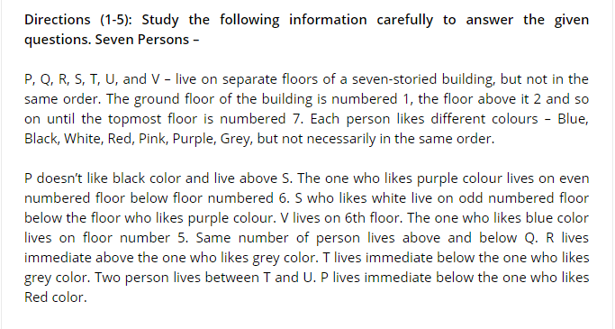

Slide 117
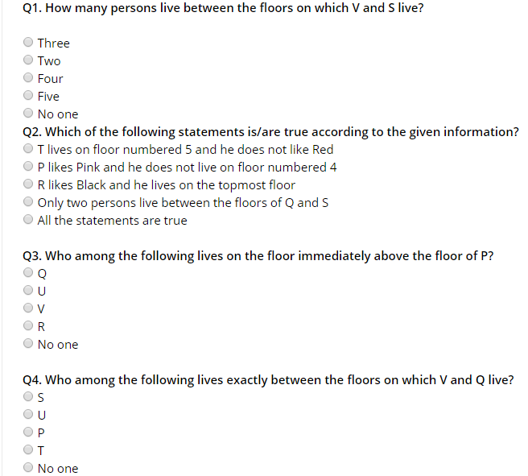

Slide 118
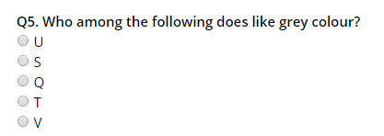

Slide 119
